Slide 1




Year 3 - Spring - Block 1
Multiplication & Division

Slide 2

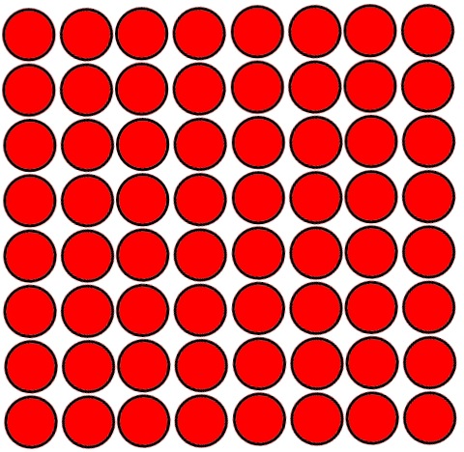
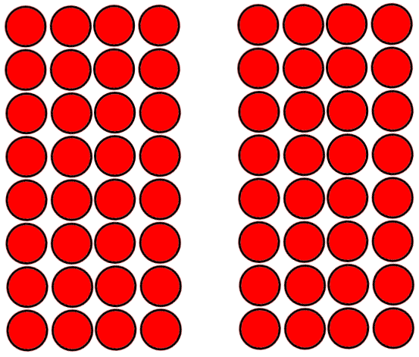
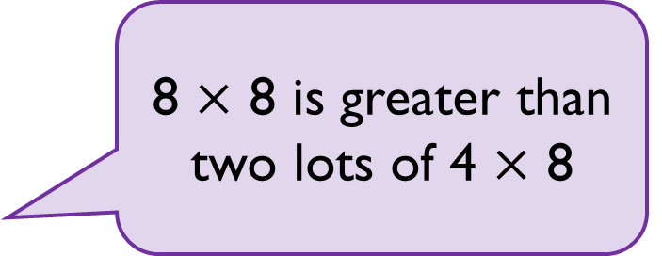
Whitney says,
Do you agree?
Can you prove your answer?
8 $×$ 8 is greater than two lots of 4 $×$ 8

Slide 3
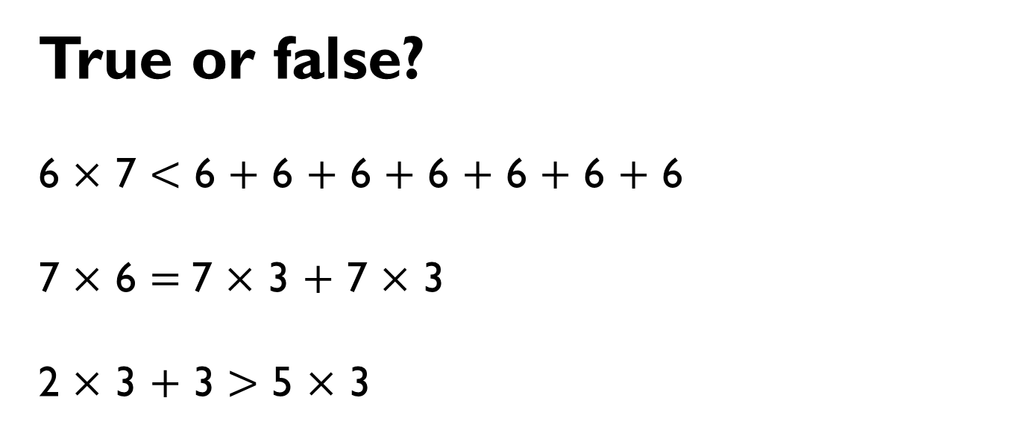
True or false?
6 $×$ 7 $<$ 6 $+$ 6 $+$ 6 $+$ 6 $+$ 6 $+$ 6 $+$ 6
7 $×$ 6 $=$7 $×$ 3 $+$ 7 $×$ 3
2 $×$ 3 $+$ 3 $>$ 5 $×$ 3

Slide 4
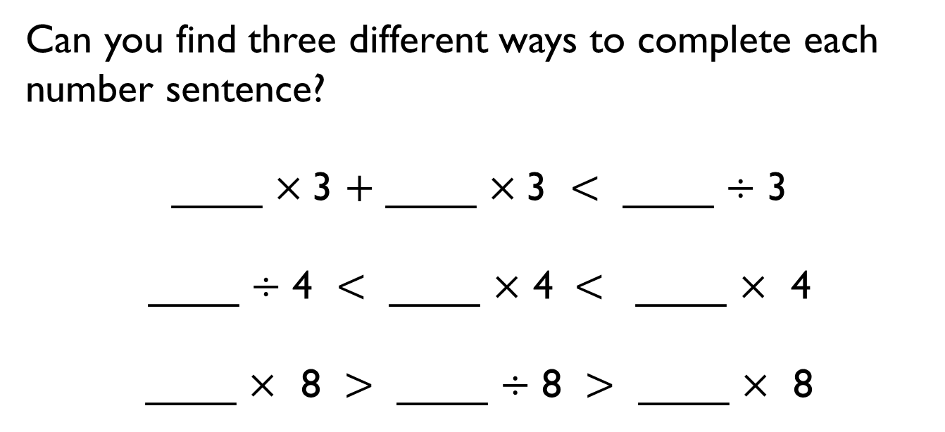
Can you find three different ways to complete each number sentence?
____ $×$3 $+$ ____ $×$3 $<$ ____ $÷$ 3
____ $÷$ 4 $<$ ____ $×$ 4 $<$ ____ $×$ 4
____ $×$ 8 $>$ ____ $÷$ 8 $>$ ____ $×$ 8

Slide 5

Is Mo correct?
Explain your answer.
I know that when multiplying 3 by 40, 40 is ten times bigger than 4, so my answer will be ten times bigger than 3 × 4

Slide 6

Rosie has 240 cakes to sell.
She puts the same number of cakes in each box and has no cakes left over.
Which of these boxes could she use?
10
20
30
40
50
60
80
100

Slide 7
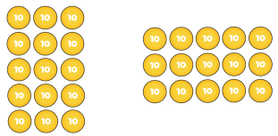


True or false?
5 $×$ 30 = 3 $×$ 50
Prove it.

Slide 8


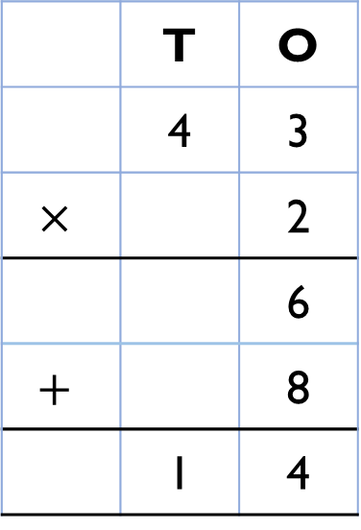
Alex completes the calculation:
43 $×$ 2
Can you spot her mistake?
 | T | O
 | 4 | 3
$$×$$ |  | 2
 |  | 6
$$+$$ |  | 8
 | 1 | 4

Slide 9
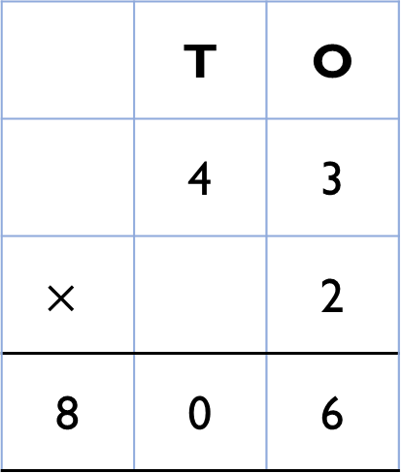
Teddy completes the same calculation as Alex.
Can you spot and explain his mistake?
 | T | O
 | 4 | 3
$$×$$ |  | 2
8 | 0 | 6

Slide 10

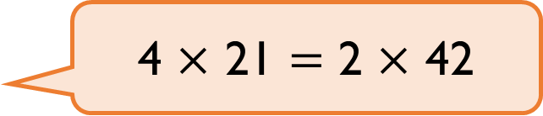
Dexter says,
Is Dexter correct?
4 × 21 $=$ 2 × 42

Slide 11
Always, Sometimes, Never?
A two-digit number multiplied
by a one-digit number
has a two-digit product.

Slide 12
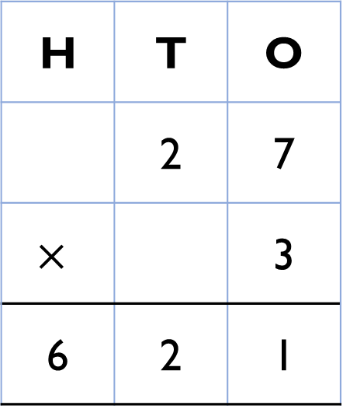
Explain the mistake.
H | T | O
 | 2 | 7
$$×$$ |  | 3
6 | 2 | 1

Slide 13


How close can you get to 100?
Use each digit card once in the multiplication.
2
3
4
$$×$$
$$=$$

Slide 14


Teddy answers the question 44 $÷$ 4 using place value counters.
Is he correct?
Explain your reasoning.
Tens | Ones

Slide 15

Dora thinks that 88 sweets can be shared equally between eight people.
Is she correct?
Tens | Ones

Slide 16




Alex uses place value counters to help her calculate 63 $÷$ 3
She gets an answer of 12
Is she correct?
Tens | Ones

Slide 17
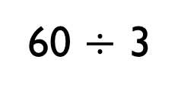

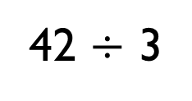
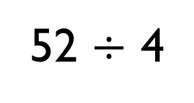
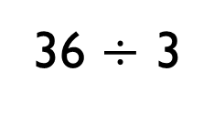
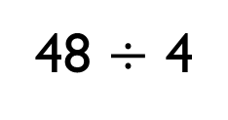
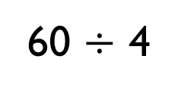
Compare the statements using $<, >$or $=$
48 $÷$ 4
36 $÷$ 3
52 $÷$ 4
42 $÷$ 3
60 $÷$ 3
60 $÷$ 4

Slide 18


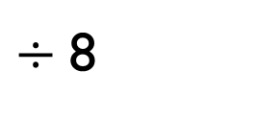
Amir partitioned a number to help him divide by 8
Some of his working out has been covered with paint.
What number could Amir have started with?
$÷$ 8
16

Slide 19
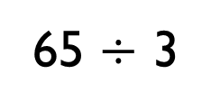
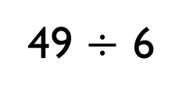
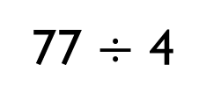
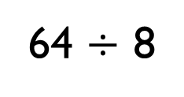
Which calculation is the odd one out?
Explain your thinking.
64 $÷$ 8
77 $÷$ 4
49 $÷$ 6
65 $÷$ 3

Slide 20




Jack has 15 stickers.
He sorts his stickers into equal groups but has some stickers remaining.
How many stickers could be in each group and how many stickers would be remaining?

Slide 21
Dora and Eva are planting bulbs.
They have 76 bulbs altogether.
Dora plants her bulbs in rows of 8 and has 4 left over.
Eva plants her bulbs in rows of 10 and has 2 left over.
How many bulbs do they each have?

Slide 22


Dora says Mo’s tower is 3 times taller than her tower.
Mo says his tower is 12 times taller than Dora’s tower.
Who do you agree with?
Explain why?
Dora’s
tower
Mo’s
tower

Slide 23
In a playground there are 3 times as many girls as boys.
There are 30 girls.
Label and complete the bar model to help you work out how many boys there are in the playground.

Slide 24
A box contains some counters.
There are twice as many green counters as pink counters.
There are 18 counters in total.
How many pink counters are there?

Slide 25









Eva chooses a snack and a drink.
What could she have chosen?
How many different possibilities are there?
_____ $×$ _____ $=$ _____
There are _____ possibilities.
How many of the ways contain an apple?

Slide 26
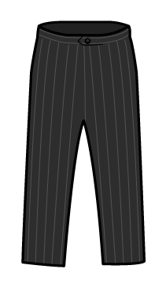

Jack has some jumpers and pairs of trousers.
He can make 15 different outfits.
How many jumpers could he have and how many pairs of trousers could he have?

