Slide 1
Year 2 - Spring - Block 4
Fractions

Slide 2
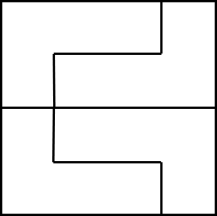
Three children are splitting a square into equal parts.
Who has split the square into equal parts?
Explain why.
Teddy
Alex
Mo

Slide 3
How many different ways can you put these beanbags into equal groups?

Slide 4

Which is the odd one out? Explain your answer.
$$\frac{1}{2}$$
One half

Slide 5
Rosie says the shaded part of the shape does not show a half because there are four parts, not two equal parts.
Do you agree? Explain why.

Slide 6
Dora is asked to shade half of her shape.
This is what she shades.
Is she correct? Explain why.
I am thinking of a number.
Half of my number is more than 10 but less than 15.
What could my number be?

Slide 7
Annie has some gummy bears.
She circles half of them.
How many gummy bears did she have at the start?

Slide 8
Alex is folding two identical paper strips.
Use paper strips to prove Alex is incorrect.
I think $\frac{1}{4}$ of the strip will be bigger than $\frac{1}{2}$ of the strip because 4 is bigger than 2

Slide 9
True or False?
$\frac{1}{4}$ of the shape is shaded.
Explain your answer.

Slide 10
Who has more? Explain why.
I have $\frac{1}{4}$ of £8
Rosie
I have $\frac{1}{2}$ of £6
Whitney

Slide 11
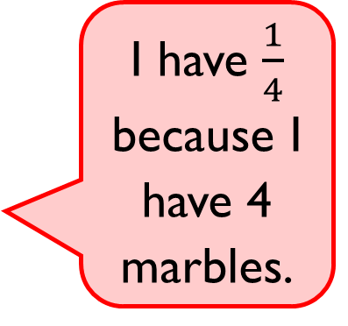
Eva says,
Do you agree? Explain why.
I have $\frac{1}{4}$ because I have 4 marbles.

Slide 12
Mo has two ribbons. He cuts $\frac{1}{4}$ from each ribbon.
$\frac{1}{4}$ of ribbon A
$\frac{1}{4}$ of ribbon B
How long were Mo’s whole pieces of ribbon?
Which ribbon was the longest? How much longer?
5 cm
4 cm

Slide 13
Dora says,
Do you agree? Explain your reasoning.
I have one third of a pizza because I have one slice and there are three slices left.

Slide 14
Alex, Annie and Whitney each show a piece of ribbon.
Whitney shows $\frac{1}{2}$ of her whole ribbon.
Alex shows $\frac{1}{4}$ of her whole ribbon.
Annie shows $\frac{1}{3}$ of her whole ribbon.
Whose whole piece is the longest?
Whose is the shortest?
Explain why.

Slide 15
Annie has a piece of ribbon.
She cuts it into three equal parts.
One third of the ribbon is 6 cm long.
How long would half the ribbon be?

Slide 16
Ron is thinking of a number.
One third of his number is greater than 8 but smaller than 12.
What could his number be?

Slide 17
True or False?
This shows $\frac{1}{4}$
Can you shade the same shape so that it shows $\frac{1}{3}$ ?

Slide 18
I am thinking of a number.
One third of my number is 12
Which will be greater, one half of my number or one quarter of my number?
Use cubes or a bar model to prove your answer.
?

Slide 19
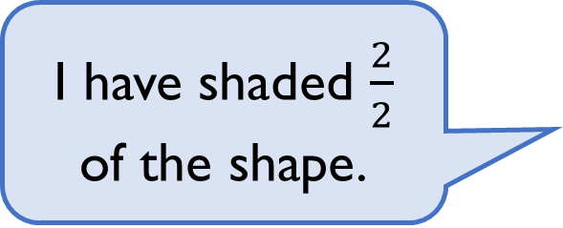
Alex says,
What mistake might Alex have made?
I have shaded $\frac{2}{2}$ of the shape.

Slide 20
Sort the fractions into the table.
What do you notice?
Are there any boxes in the table empty?
What fraction could you write here?
 | Fractions equal to one whole | Fractions less than one whole
Unit fractions
Non-unit fractions
$$\frac{3}{4}$$
$$\frac{2}{2}$$
$$\frac{1}{3}$$
$$\frac{1}{4}$$
$$\frac{4}{4}$$
$$\frac{3}{3}$$
$$\frac{1}{2}$$
$$\frac{2}{3}$$

Slide 21
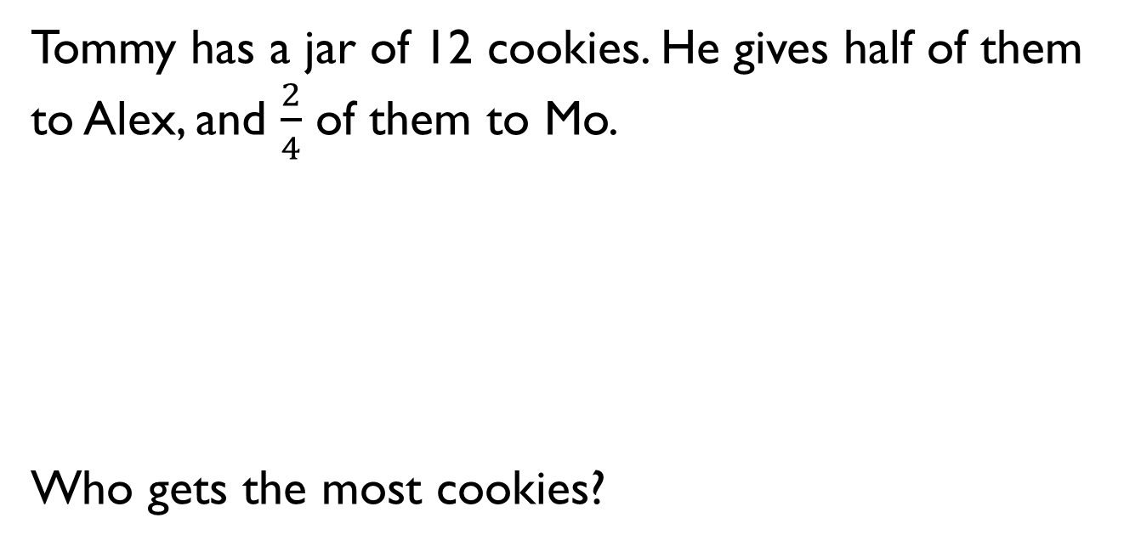
Tommy has a jar of 12 cookies. He gives half of them to Alex, and $\frac{2}{4}$ of them to Mo.
Who gets the most cookies?

Slide 22
Using red and blue cubes, build two towers to convince me that $\frac{1}{2}$ and $\frac{2}{4}$ are equal.

Slide 23
Whitney says:
Do you agree?
Explain why.
Why do you think Whitney thinks this?
I have shaded a third of my shape.

Slide 24
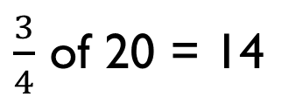
Amir is using beanbags and hoops to find three quarters of 20
Can you spot his mistake?
$\frac{3}{4}$ of 20 = 14

Slide 25
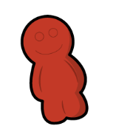
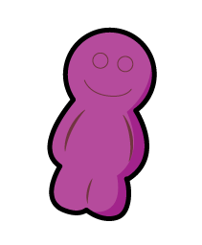
Eva eats three-quarters of her sweets.
She eats these sweets.
How many sweets does Eva have left?

Slide 26
Look at this pattern.
What would come next?
Write the next fraction and draw the representation.
What would be the 8th fraction in the pattern?

Slide 27
Alex and Whitney are counting in quarters.
Who is correct? Explain your answer.
One quarter, two quarters, three quarters, four quarters…
Alex
One quarter, one half, three quarters, one whole…
Whitney

