Slide 2
Persuasive
Purpose:
To argue the case for a point of view.
To attempt to convince the reader.
Structure
Opening statement – Introduce your point of view to the reader.
Arguments – state the point of view and evidence for each argument.
Conclusion – summarise the points, repeating your point of view.

Slide 3
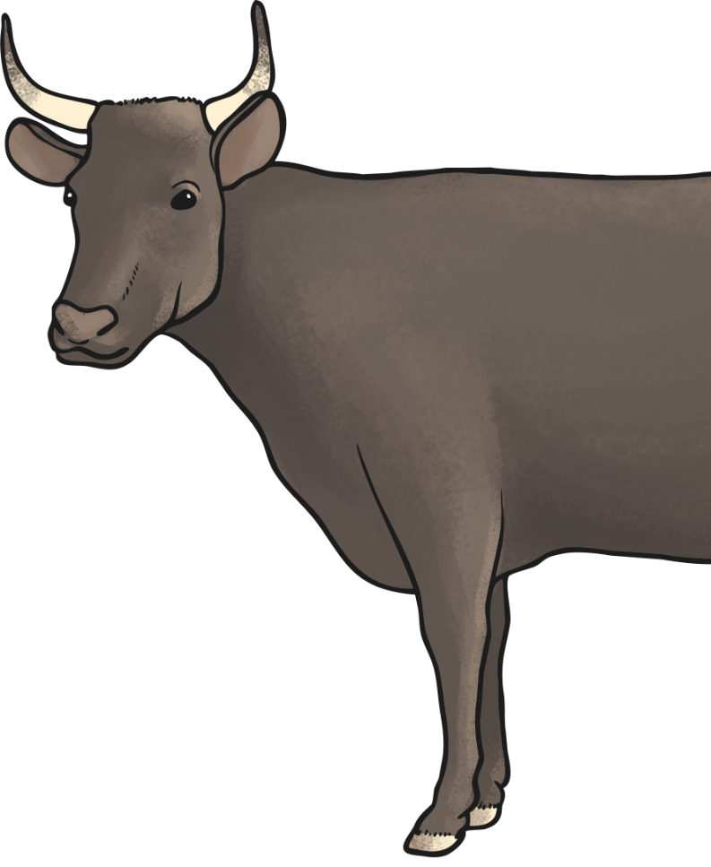
Features
Persuasive writing is written in the present tense.
e.g. Most beef sold in the UK is not British.
Logical connectives are used in persuasive writing to make the points and evidence flow.
Here are some examples:
because
however
this shows

Slide 4
Features
Use facts when writing persuasive text, it gives evidence and proof to the argument rather than persuasive comments.
Give the reader a reasonable argument, get the reader interested and on your side.
Fascinate the reader, with interesting and shocking facts so that they agree with you.
Short sentences help give points emphasis.
Persuasive writing is about informing the reader about a subject and getting them to agree. Writing in a friendly manner is key.

Slide 5
Features
Using strong, clear, positive language helps the reader to agree with you.
Below are some helpful phrases that are used in persuasive writing.
Persuasive phrases:
As a result…
This causes…
Another reason…
It goes without saying…
I strongly believe…
Is it really worth…
How could we possibly…

Slide 6
Features
Make the reader think that everyone else does this, agrees or that it will make their life better or them a happier person.
e.g. Everyone agrees that….
We all know that…
Alliteration can make slogans more memorable.
e.g. Buy British Beef
Using humour in persuasive writing can help people take your side.
A picture that tugs at the heart-strings can be more powerful than 1000 words.

Slide 7
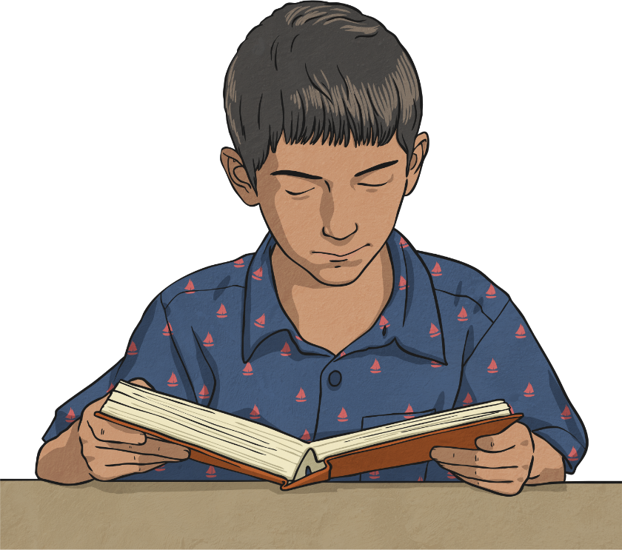
Features
Finally re-read.
Would you be persuaded?

Slide 8
WAGOLL Intro
Dear Dr Leila,
I am writing to you to ask for more medicine for my old, fragile granny.
A lot of things have happened over the past year that are unimaginable. A month in to this deadly war, I lost my beautiful mother as the bombs littered the street that my house lay in. As a result of this all of our belongings and memories were burnt and lost in that cruel moment. Granny was then left with an enormous responsibility to look after myself and my two younger brothers, and ensure that we have all of the essentials we need. I, myself have found it difficult to watch over Latif and Ahmed and so I have no idea how or if Granny is coping.
It has occurred to me that I have not seen Granny take the medicine that you had prescribed to her and as a result, I have seen her getting paler and paler. All I have been thinking is how could we possibly get more medicine when the street that our new, blown out house sits in is constantly battling with others leaving bullet shells and explosives everywhere?

